Slide 1

New York City Vehicle Collision Analysis
BUAN 6340.003 - Programming for Data Science
Prepared by:
Amod Karambelkar
ask171630

Slide 2


ABOUT NYC DATASET
Data has been acquired from NYC Open Data
This dataset has 644099 rows & 19 columns
The Data is filtered and few values are taken for each month
Some of the key attributes of this dataset include:
Types of Accidents
Contributing Factors
Time

Slide 3

Problem Statement
Analyzing the factors that affect vehicle collisions in NYC

Slide 4
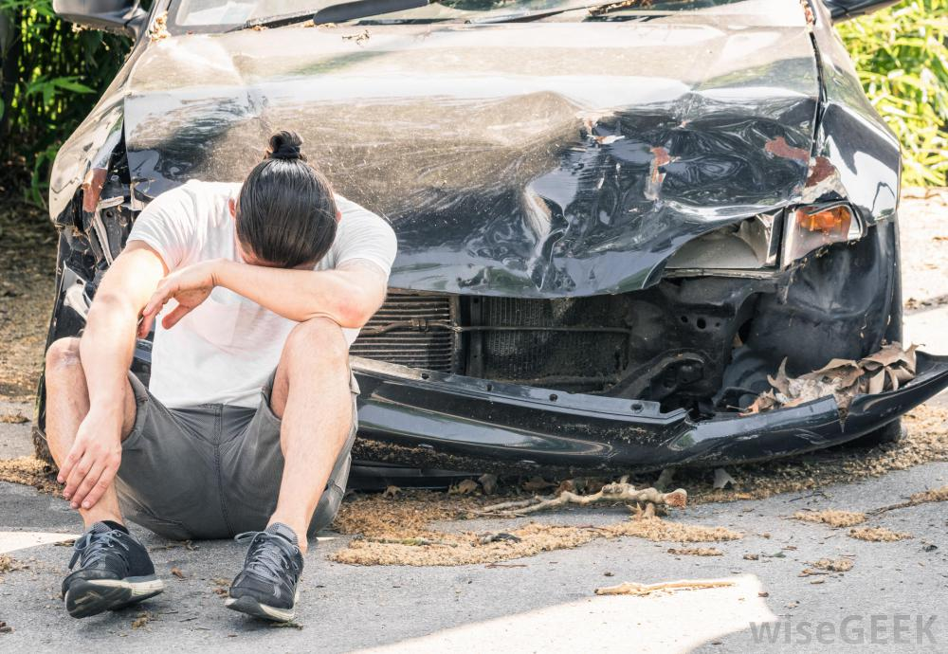
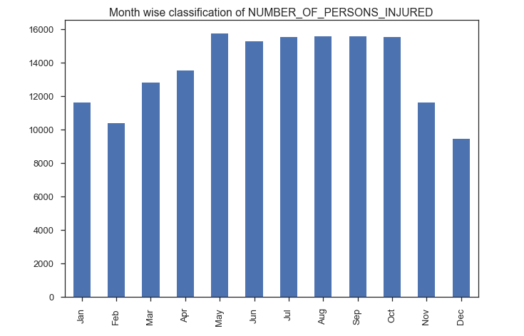
Number of Persons Injured Per Month
Maximum number of injuries have occurred in the month of May-Oct

Slide 5

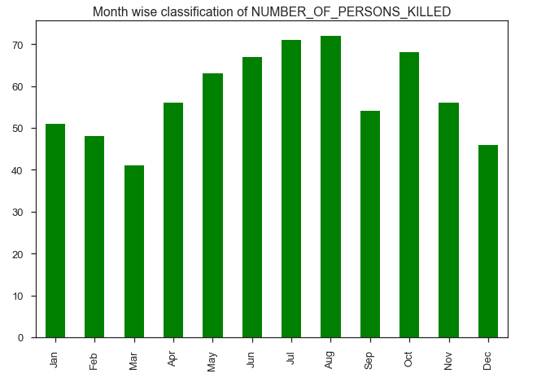
Number of Persons Killed Per Month
Maximum number of deaths have occurred in the month of July-August

Slide 6
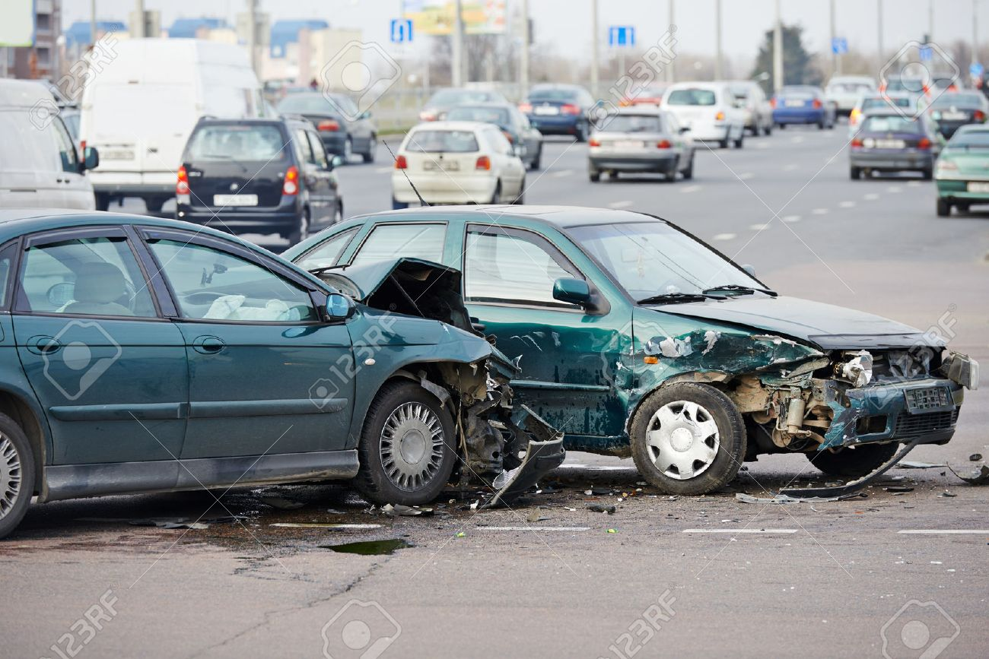
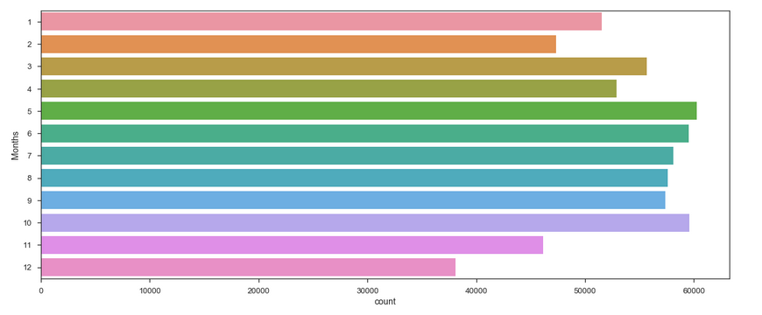
Month wise classification of number of collisions
There are less collisions, injuries and deaths between the months Nov-Feb.
As these are cold times of the year people might rather take public transport.
As this is also time for Holidays people usually spend their time with their families.

Slide 7
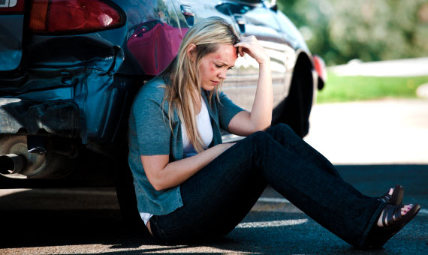
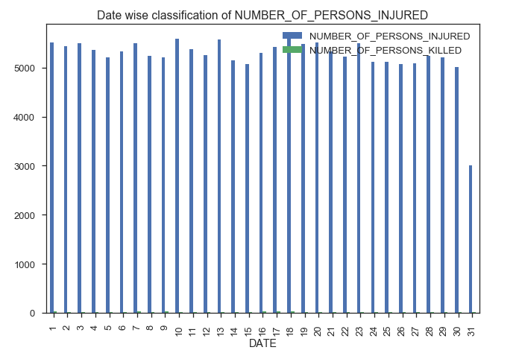
Number of persons injured per Day
We do not have any inference here with respect to the day of the month.

Slide 8
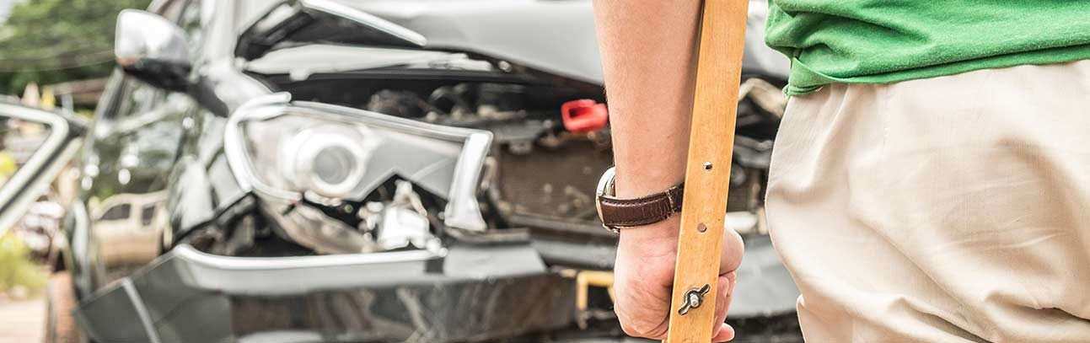
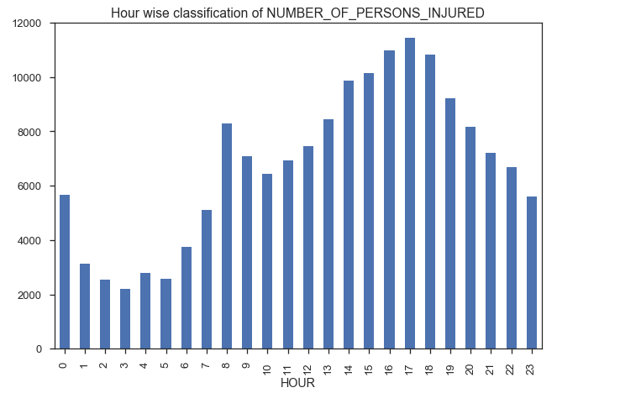
Number of persons injured per Hour
Maximum number of injuries have occurred during 16:00-18:00hours
This also indicates that accidents happen after office work hours

Slide 9

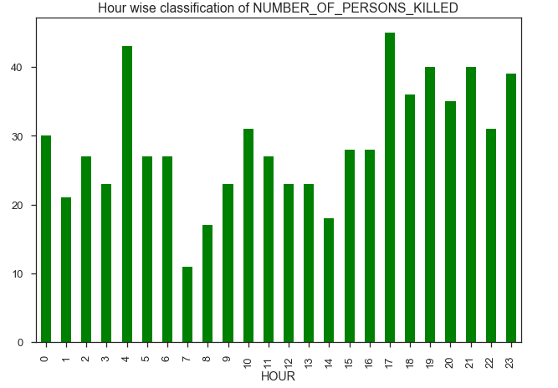
Number of persons Killed per Hour
Interestingly we have a large number of people killed around 4AM.
This may indicate drunk driving post parties

Slide 10
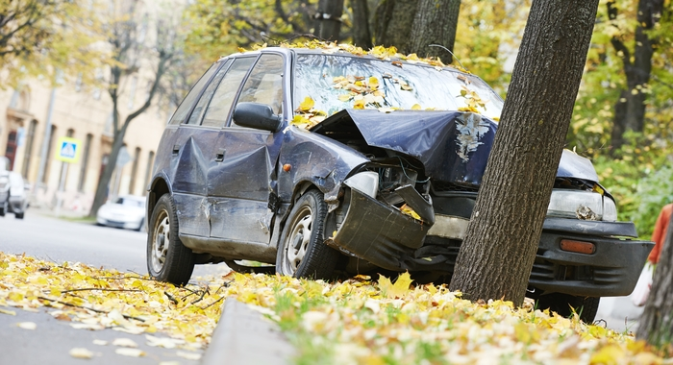
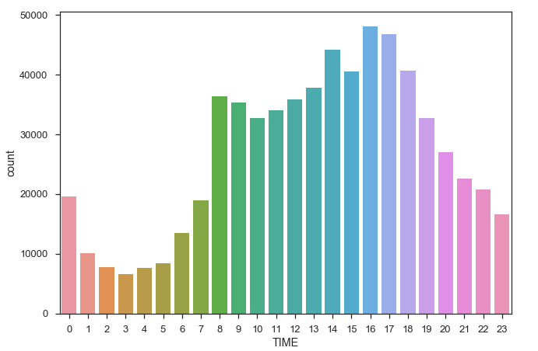
Hour wise classification of number of collisions
Maximum collisions take place around 8AM and 5-6PM. These are peak times for office travel
Maximum injuries are occurring during the same time

Slide 11
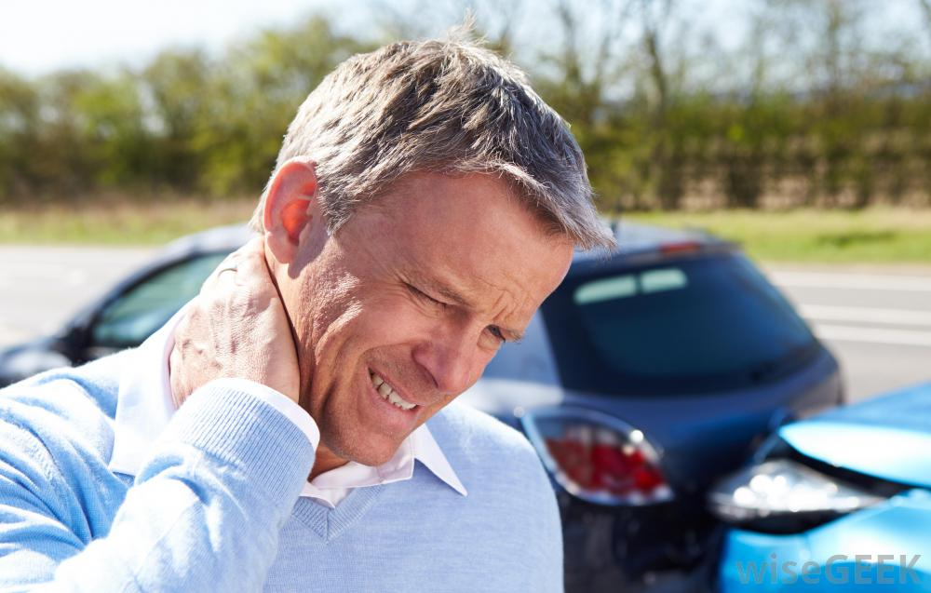
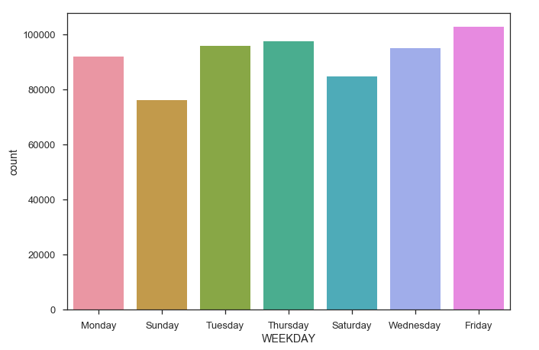
Analysis based on day of the week
Friday is the day of the week where we would ideally encounter most of the Collisions

Slide 12
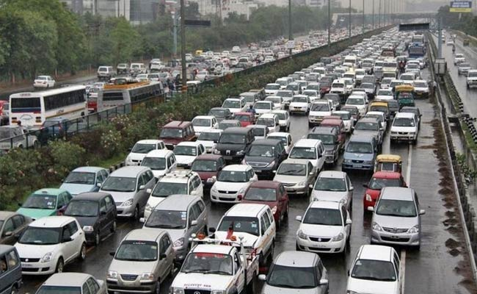
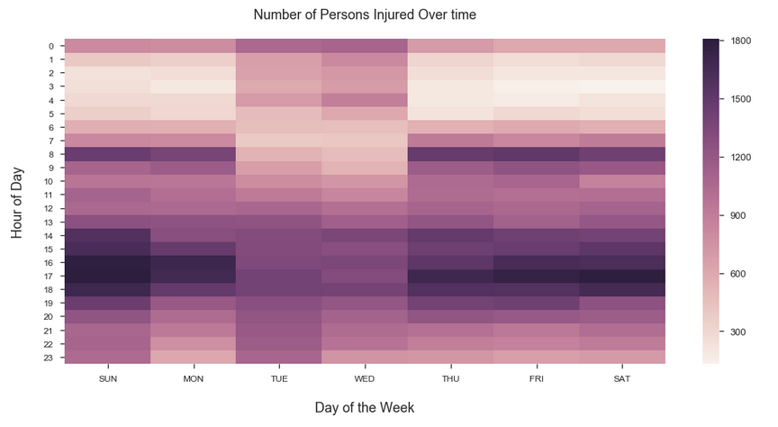
Number of Persons Injured Over time
We see that number of injuries are more during the peak hours 8 AM and 5PM as inferred earlier
Tuesdays and Wednesdays turn out to be exceptions.

Slide 13

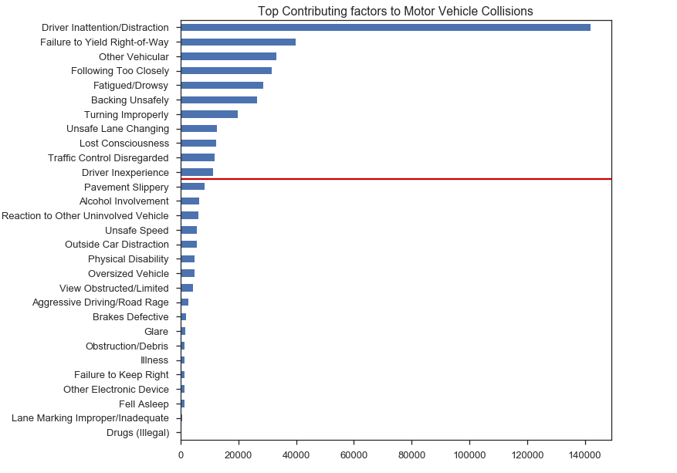
Top Contributing factors to Motor Vehicle Collisions
Driver Inattention caused the most collisions.
This might be because of attention towards Mobile Phone, Music or even other person.

Slide 14

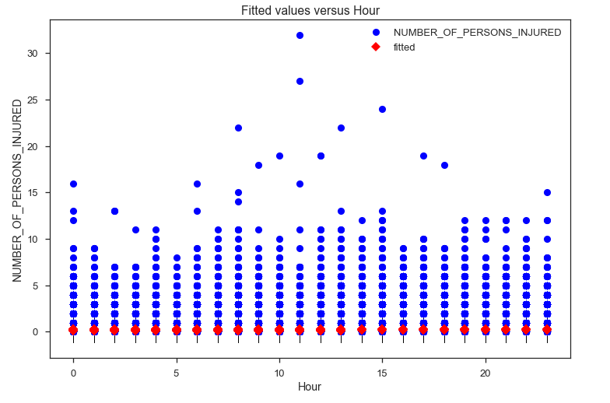
LINEAR REGRESSION
F-static is 422.8 & is significant.
Also P values are close to zero.
But R-squared is very low, hence insignificant.
We thus predict injuries on an hourly basis using polynomial regression.

Slide 15
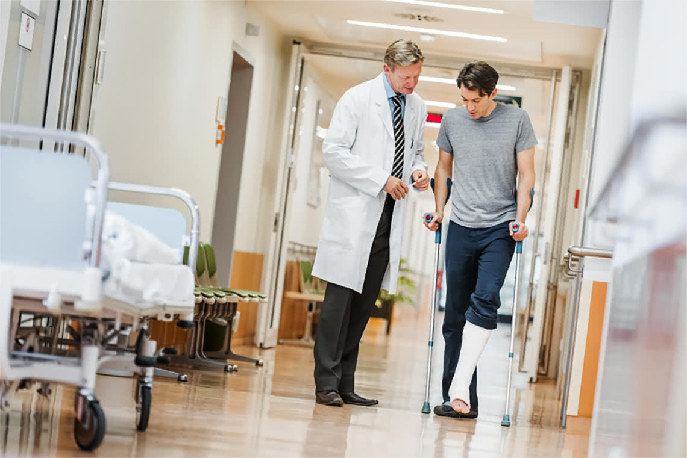
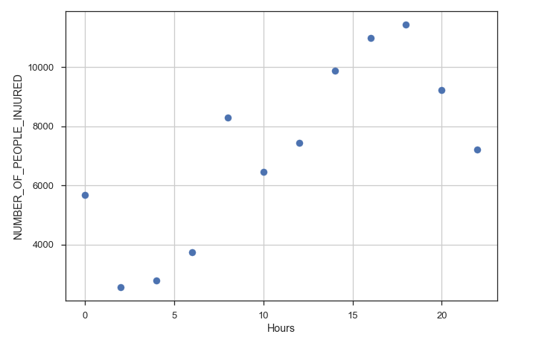
Number of People Injured per hour
Highest Number of Injuries between 16:00- 17:00hrs which can be inferred from previous slides as well.

Slide 16
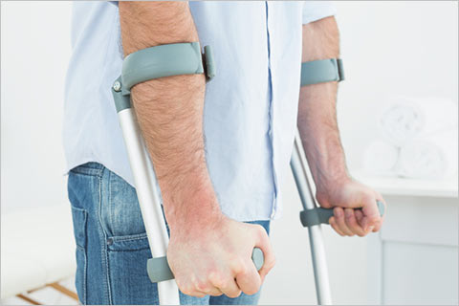
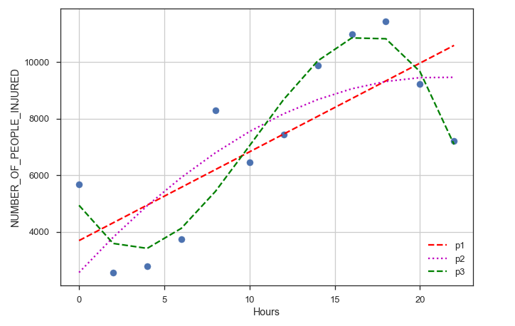
Number of People Injured per hour using Polynomial Regressions
Polynomial Regression of power 3 covers most of the points and hence fits our data closely

Slide 17
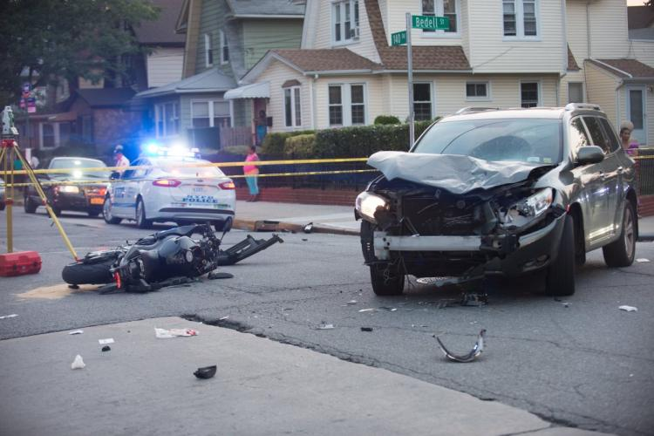
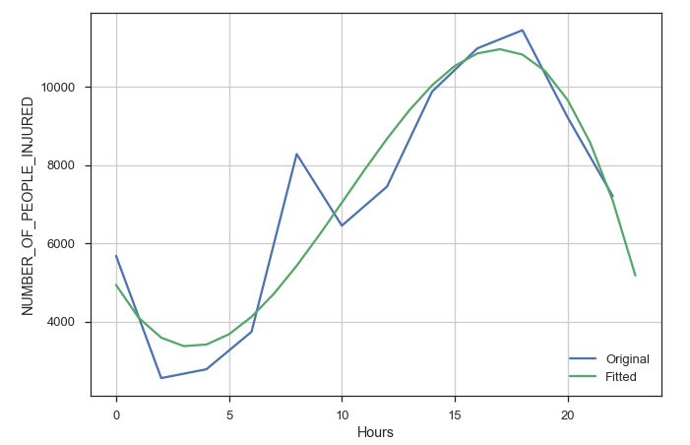
Original vs Predicted Model
As evident from the graph, our original model and the fitted model are very close except for 1 deviation.
So the predictions are pretty accurate.

Slide 18
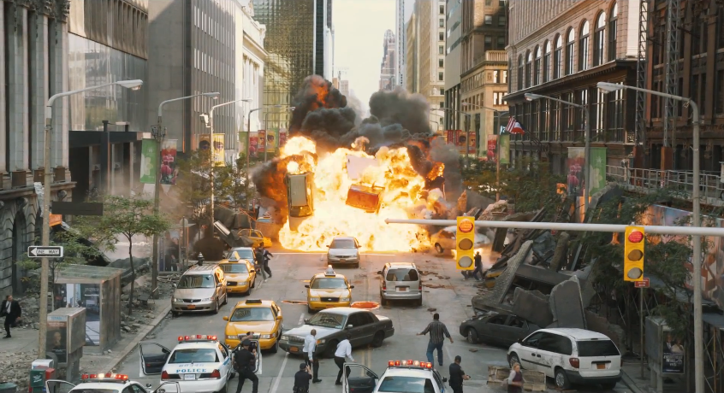
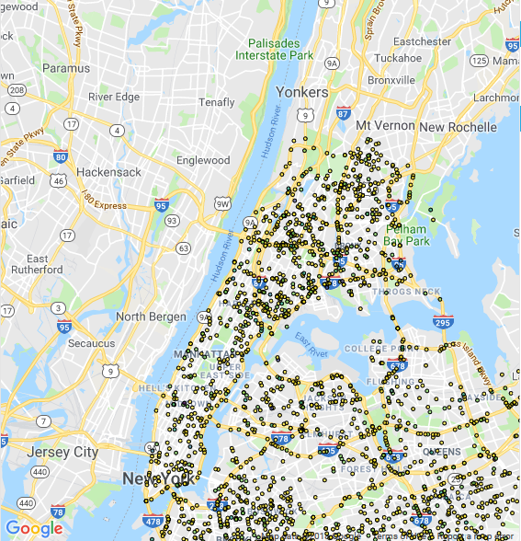
BOKEH PLOT
We Plot a Bokeh Plot of number of people injured at a particular location using the latitude and longitude data.
We can thus visualize which areas are more vulnerable to accidents on Google Maps.

Slide 19

CONCLUSION
Based on top contributing factors that lead to collision and the time and location, we can curb the same by strict patrolling and providing driver education.
The dataset can be further analyzed to get more meaningful insights.

